Slide 1



Flights Analysis Project
Maryann Meilika
Notes:
Line spacing + Page numbers

Slide 2
Analytics Project
The aviation areas generate huge amounts of data
• Weather, flight information and sensor data can be used to develop predictive model using big data analytics
• Influence of weather on the flight delays can lead to helpful insights for the airport and airline operations to enhance flight safety, improve customer satisfaction and reduce flight delays

Slide 3
Taxi Out time plays a role for the companies owning the planes. So companies try to minimize their taxi time as both convenience to the customer and themselves by minimizing the amount of time the passenger spends in the plane but also saving cost due to the less fuel burn.
• Airline companies can make proper arrangements for the passengers if the flight is getting delayed and make any schedule change for connecting flights
• Citizens can arrange for change in their plans after the flight in case the flight is getting delayed

Slide 4
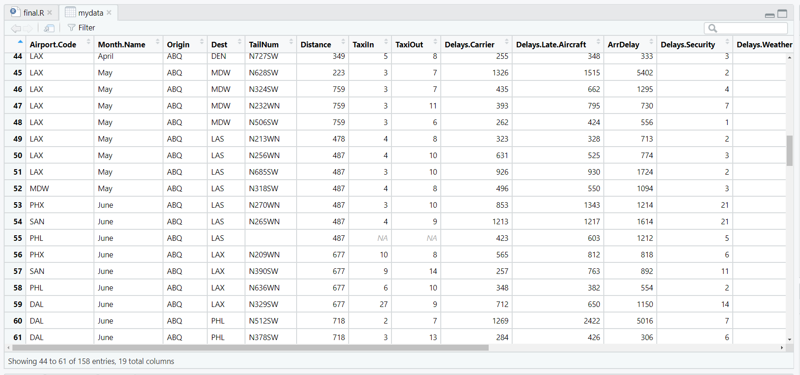
View flights dataset

Slide 5
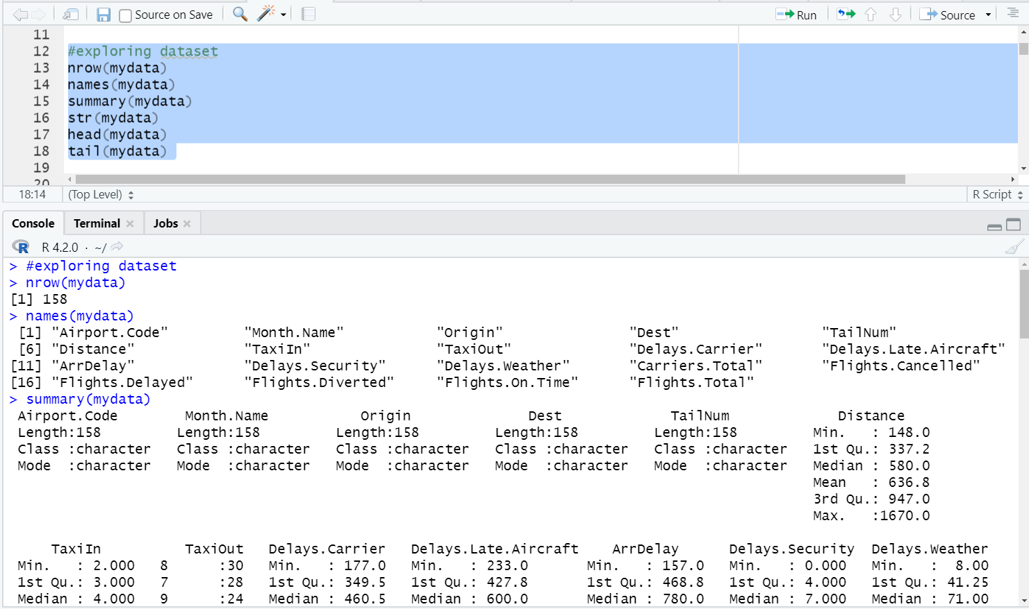
exploring dataset

Slide 6
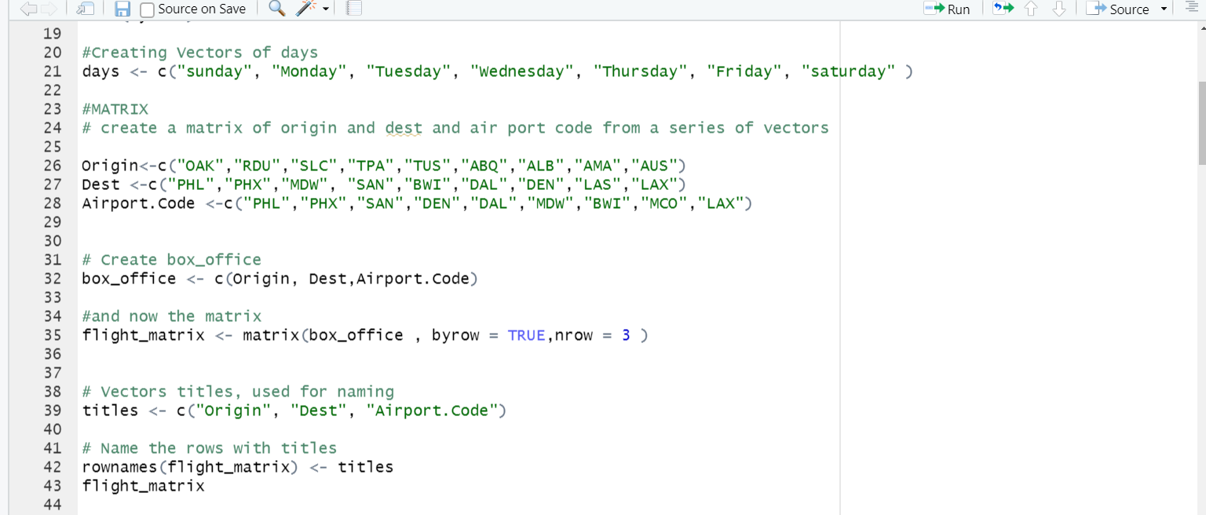
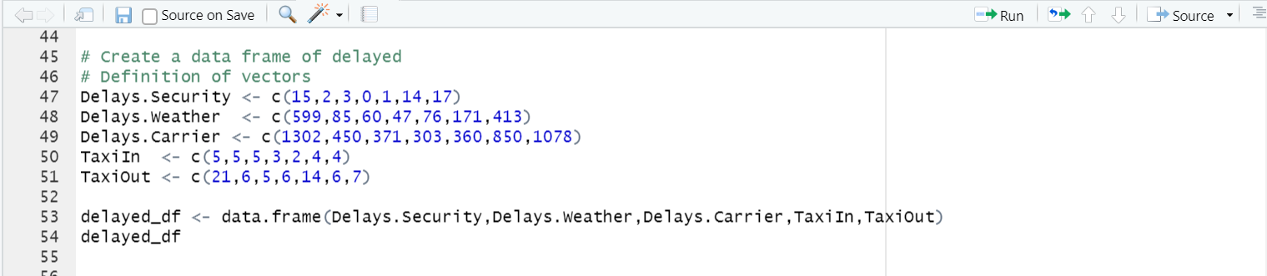
data structures
Vector
Matrix
Data frame

Slide 7
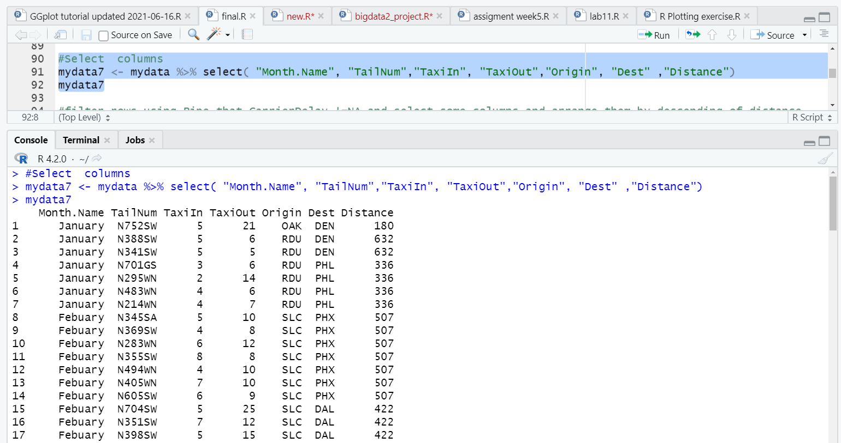
Using the DPLYR library
1- Select including sub setting

Slide 8
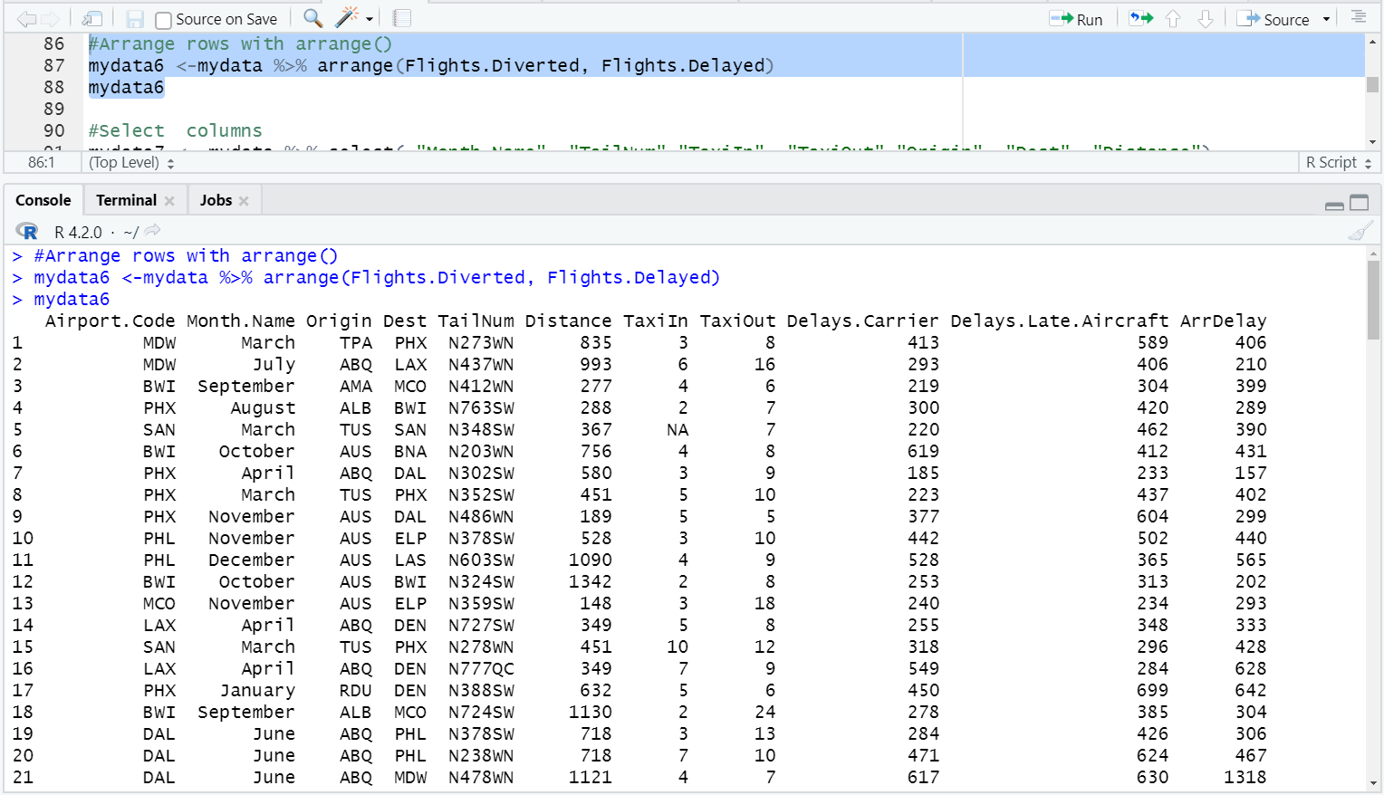
Arrange

Slide 9
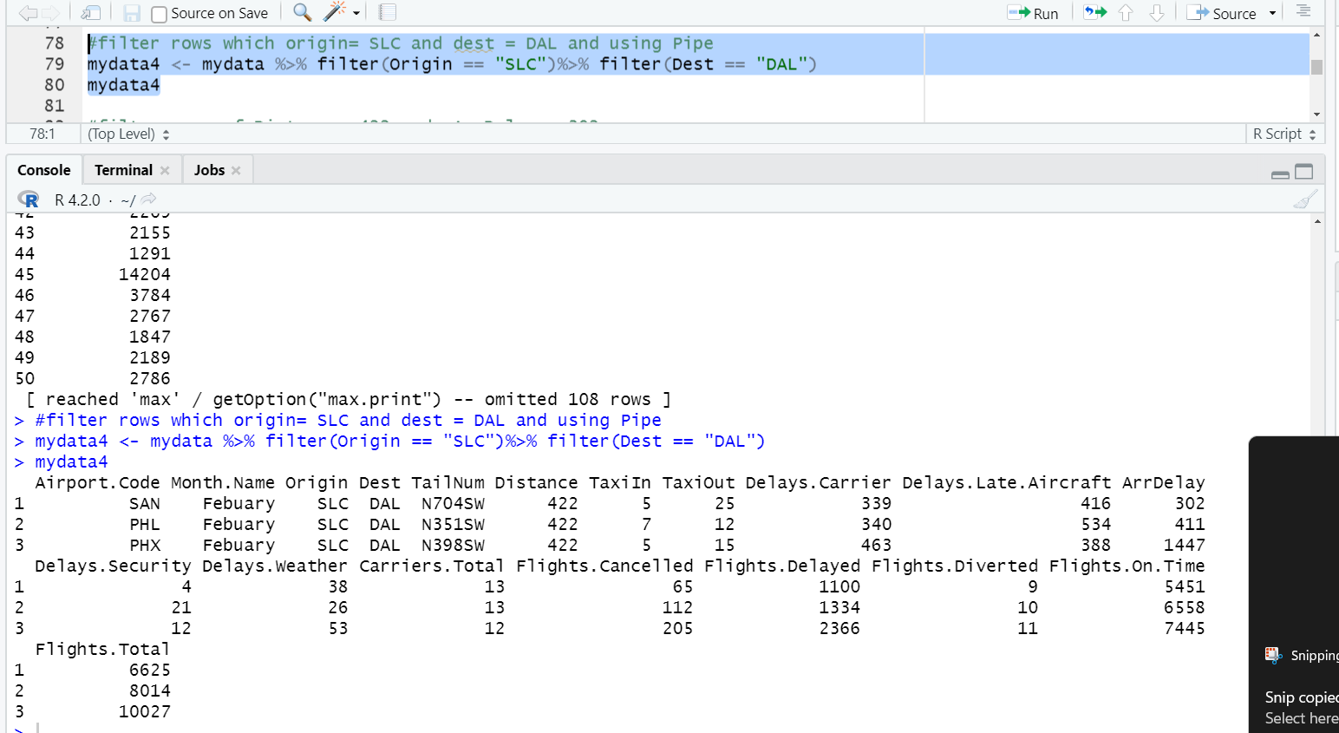
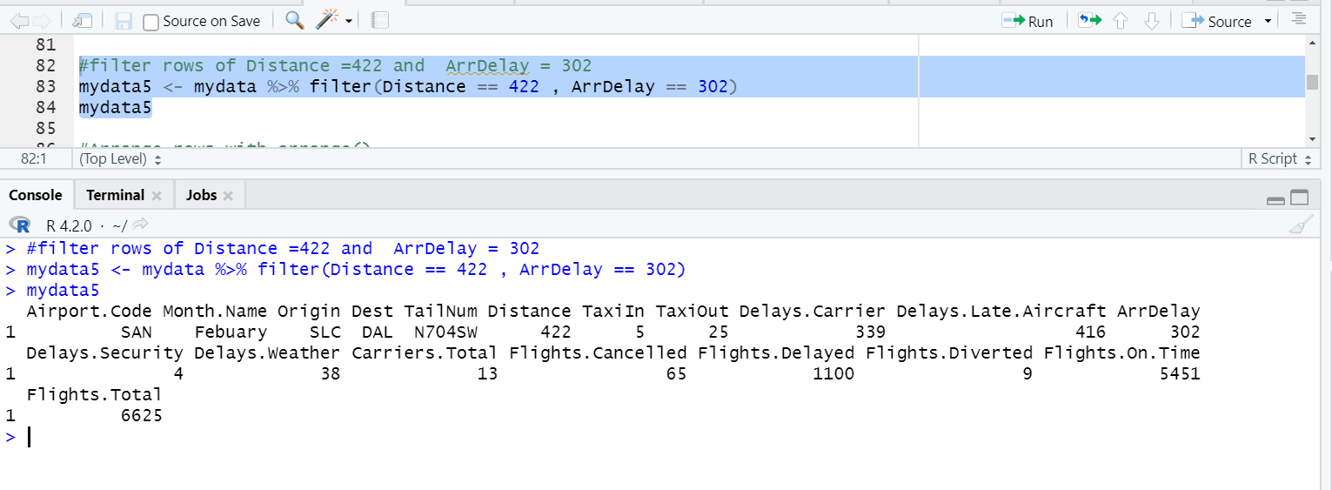
Filter

Slide 10
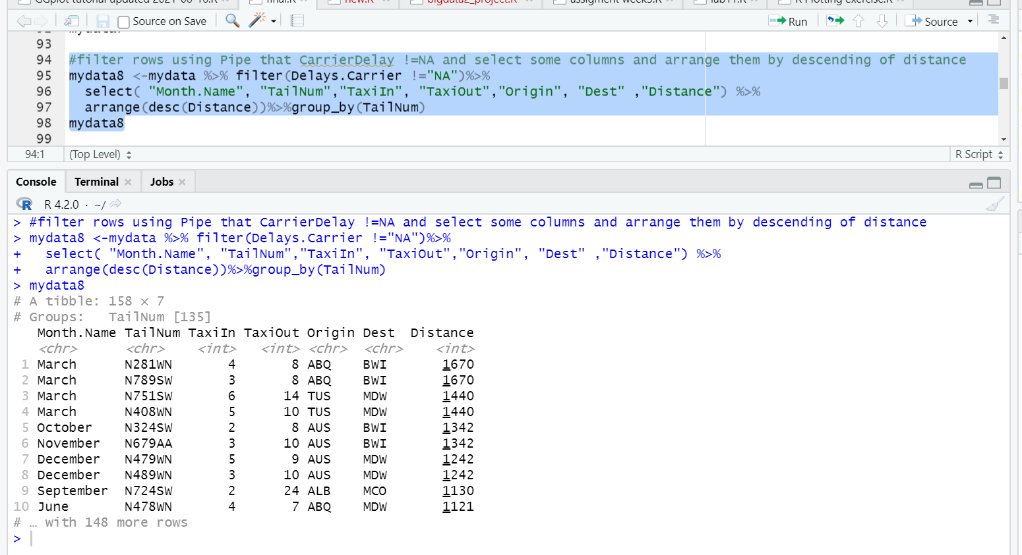
Pipe

Slide 11
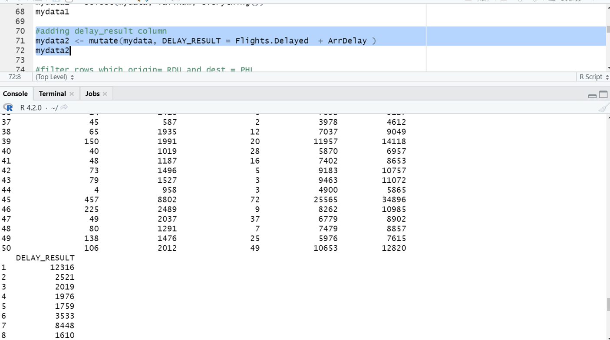
Mutate

Slide 12
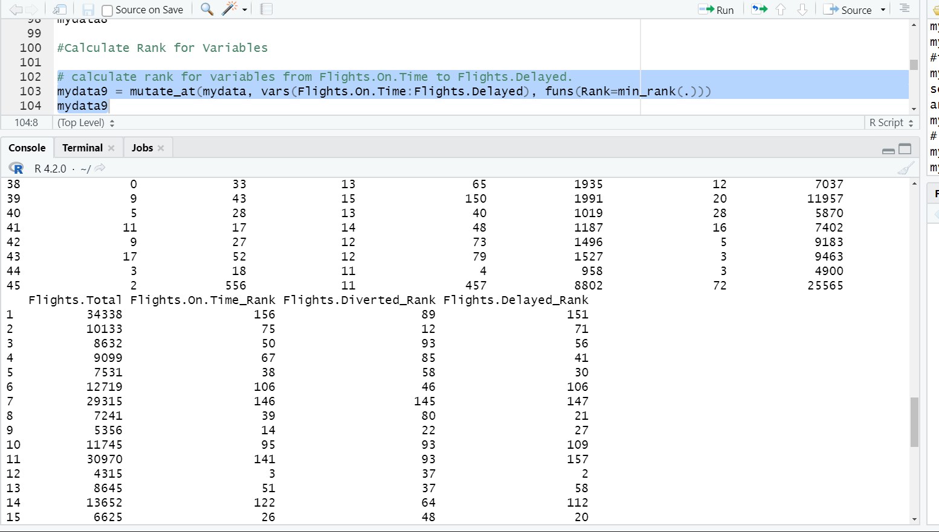
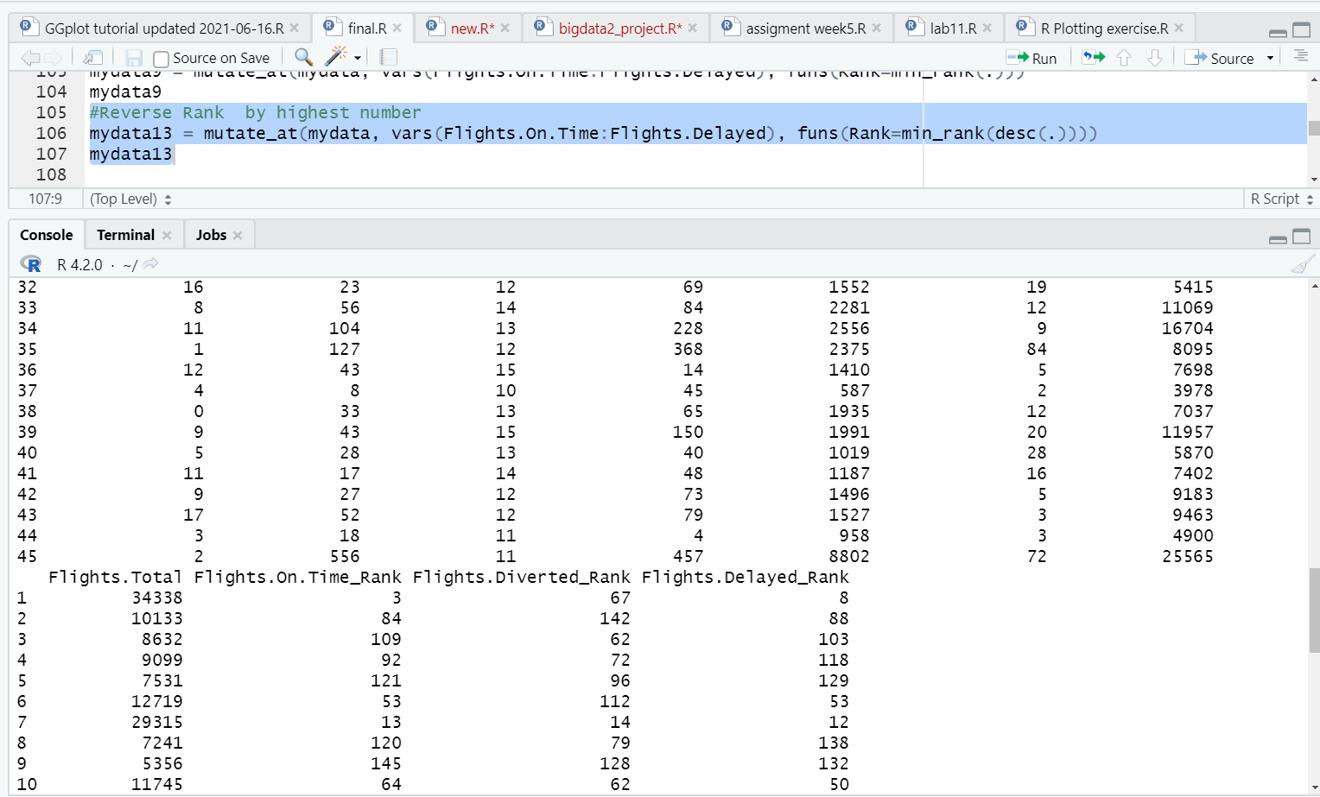
Rank

Slide 13
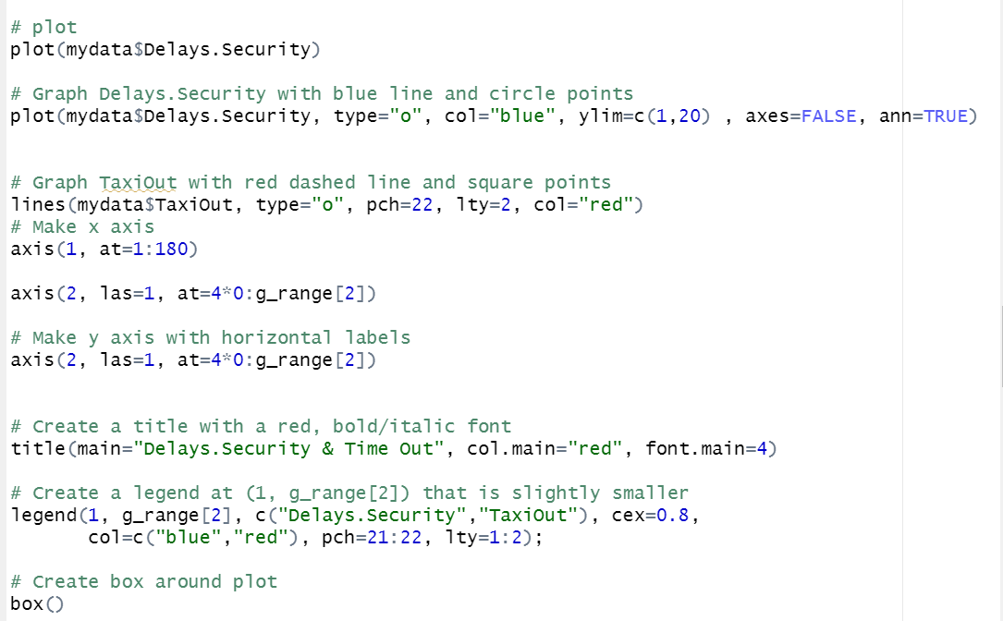
Charting
1- Plots

Slide 14
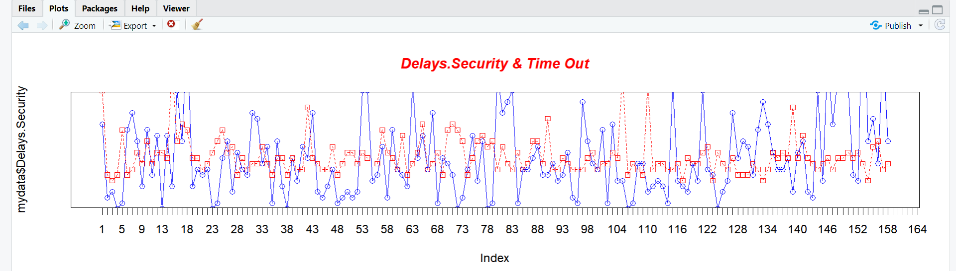
Charting
1- Plots

Slide 15
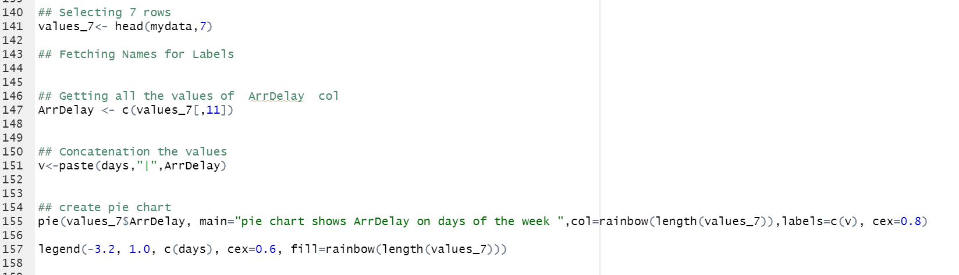
Charting
2- Pie

Slide 16
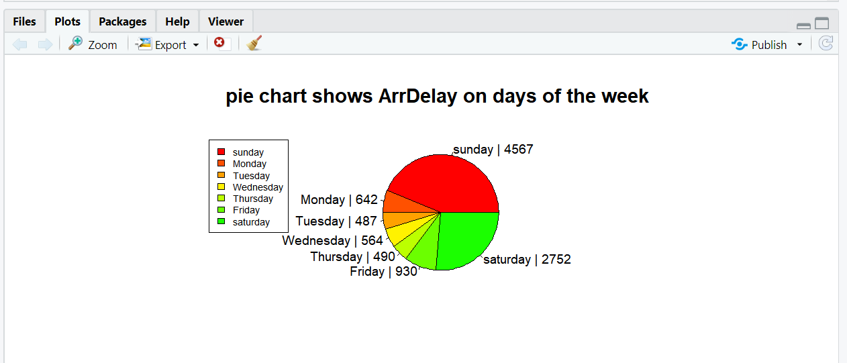
Charting
2- Pie

Slide 17
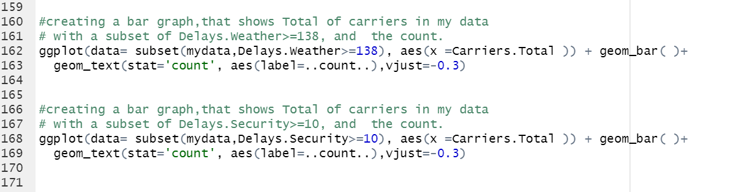
Charting
3- Bar

Slide 18
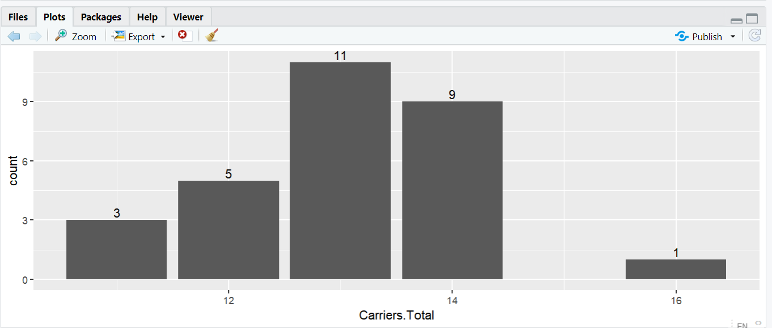
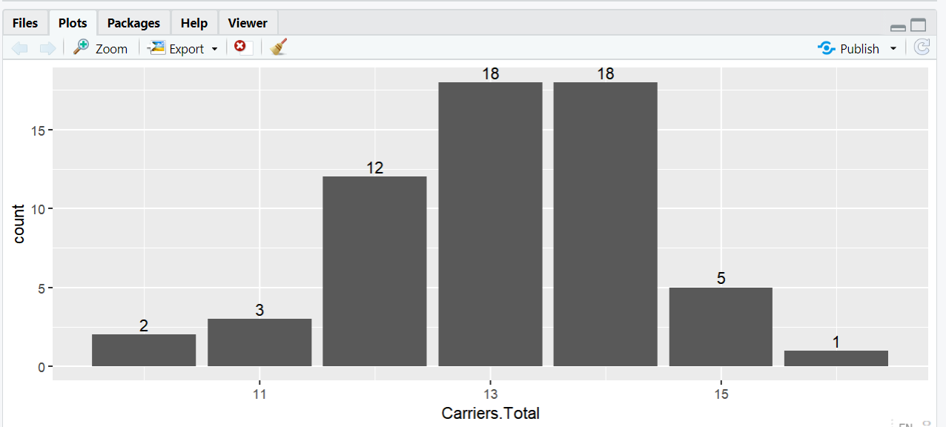
Charting
3- Bar
shows Total of carriers in my data with a subset of Delays.Weather>=138, and the count.
bar graph,that shows Total of carriers in my data with a subset of Delays.Security>=10, and the count.

Slide 19
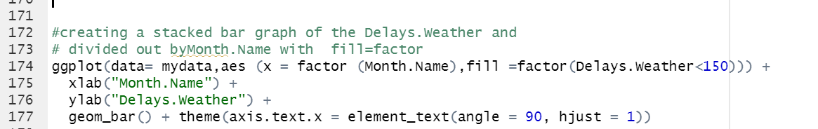
4-stacked bar

Slide 20
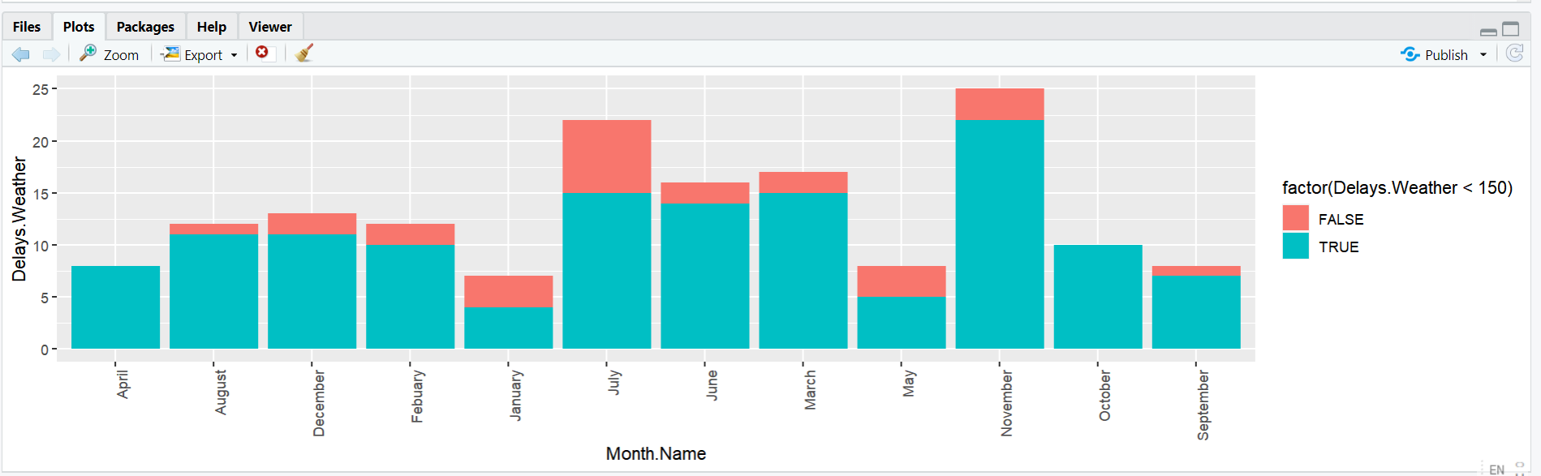
4-stacked bar
The graph Shows the Delays.Weather that<150 and divided out by Month.Name with fill=factor

Slide 21
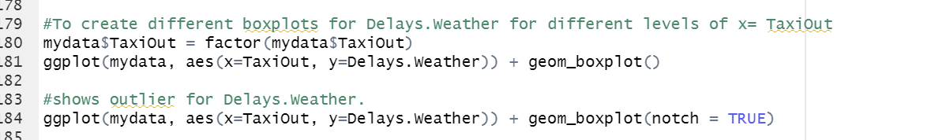
5- boxplots & outlier

Slide 22
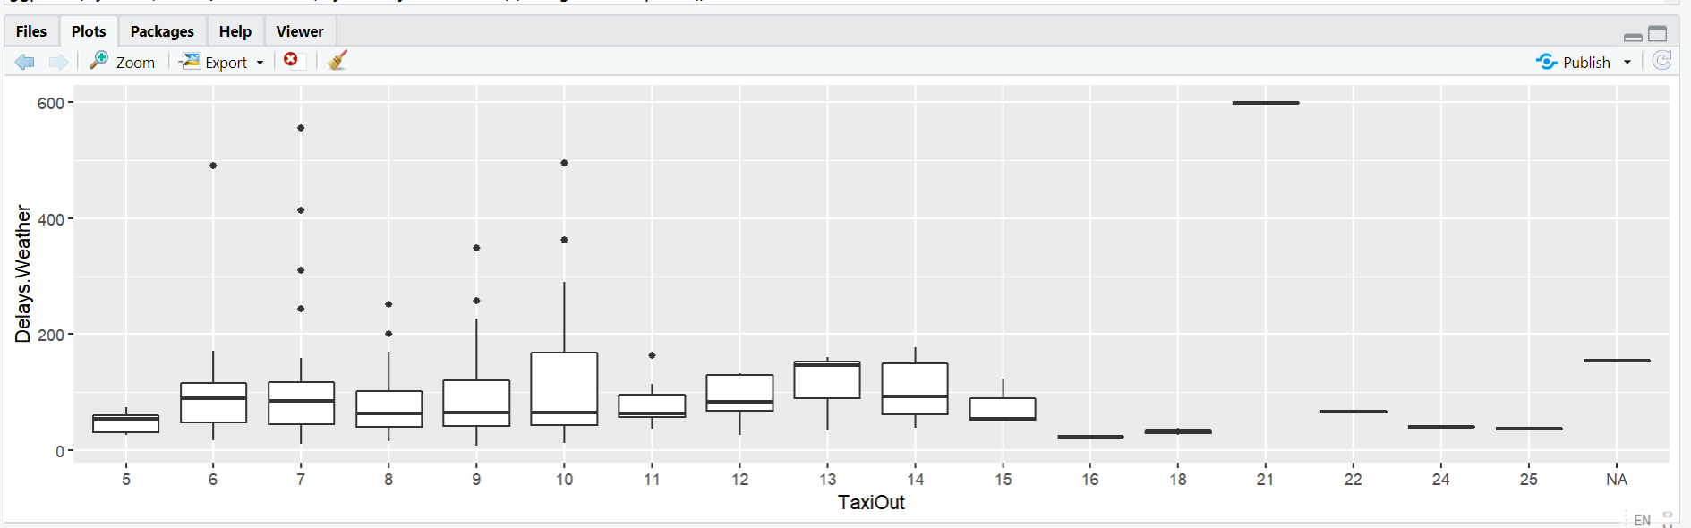
5- boxplots
create different boxplots for Delays.Weather for different levels of x= TaxiOut

Slide 23
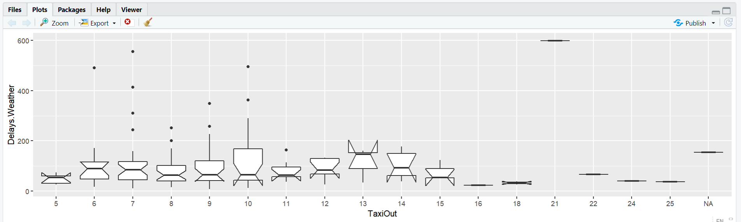
shows outlier for Delays Weather

Slide 24
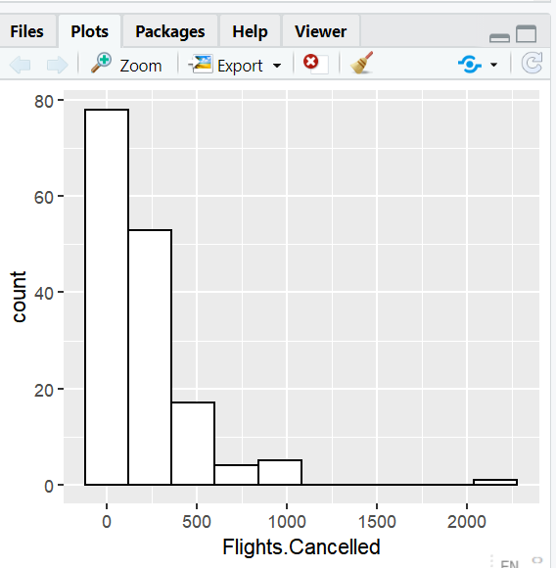
6- histogram

Slide 25
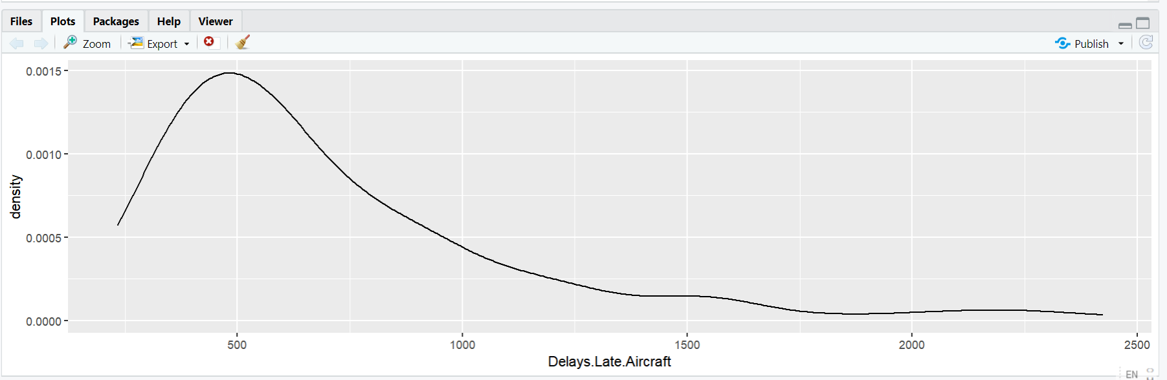
7- Density Plot
presents the distribution of a Delays Late Aircraft.

Slide 26
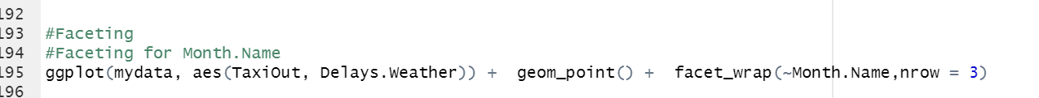
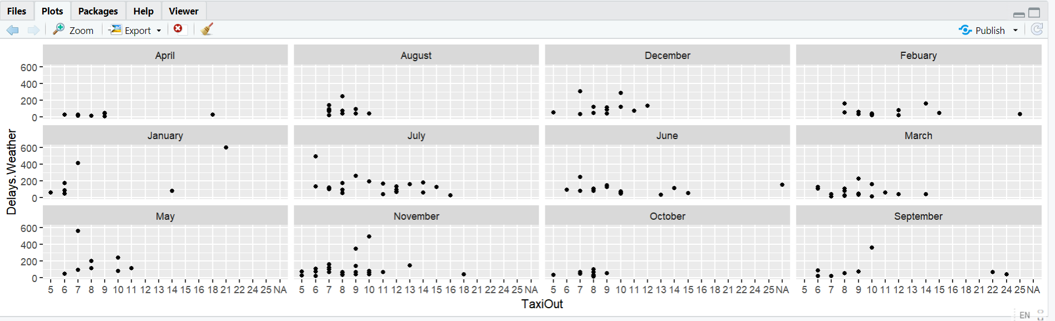
8- Faceting
ggplot(mydata, aes(TaxiOut, Delays.Weather)) + geom_point() + facet_wrap(~Month.Name,nrow = 3)

Slide 27

Thank you

